Slide 1
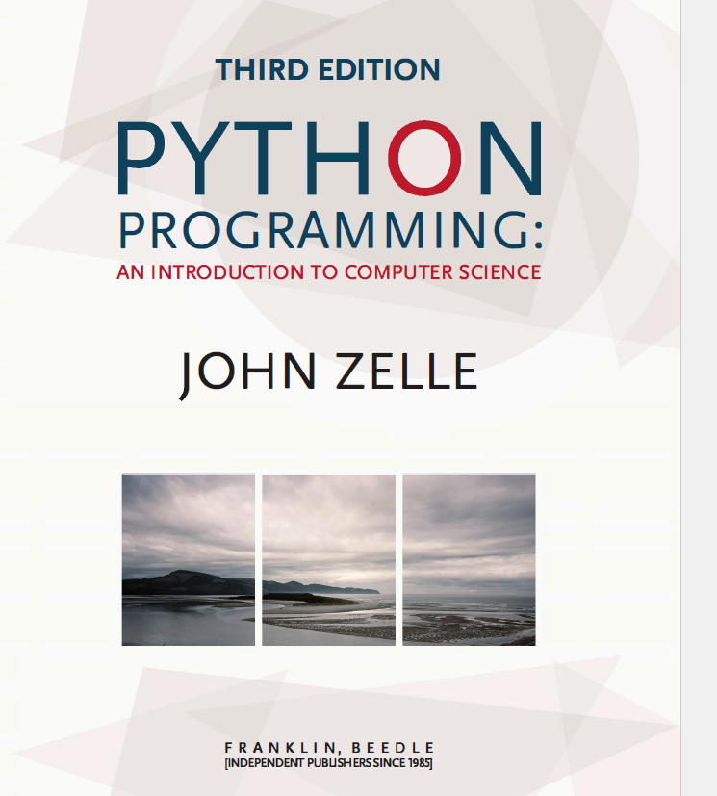

Slide 2
Python Programming: An Introduction to Computer Science
Chapter 1
Computers and Programs

Slide 3
Objectives
To understand the respective roles of hardware and software in a computing system.
To learn what computer scientists study and the techniques that they use.
To understand the basic design of a modern computer.
To understand the form and function of computer programming languages.
To begin using the Python programming language.
To learn about chaotic models and their implications for computing.

Slide 4
1.1 The Universal Machine
Have you ever stopped to wonder what exactly a computer is?
How can one device perform so many different tasks?
These basic questions are the starting point for learning about computers and computer programming

Slide 5
1.1 The Universal Machine
A modern computer can be defined as “a machine that stores and manipulates information under the control of a changeable program.”
Two key elements:
Computers are devices for manipulating information.
Computers operate under the control of a changeable program.

Slide 6
1.1 The Universal Machine
What is a computer program?
A detailed, step-by-step set of instructions telling a computer what to do.
If we change the program, the computer performs a different set of actions or a different task.
The machine stays the same, but the program changes!

Slide 7
1.1 The Universal Machine
Programs are executed, or carried out.
All computers have the same power, with suitable programming, i.e. each computer can do the things any other computer can do.
The universal machine can do anything you want it to do, provided you can describe the task to be accomplished in sufficient detail.

Slide 8
1.2 Program Power
Software (programs) rule the hardware (the physical machine).
The process of creating this software is called programming.
Computer programming is a challenging activity.
Good programming requires an ability to see the big picture while paying attention to minute detail.

Slide 9
1.2 Program Power
Why learn to program?
Fundamental part of computer science
Having an understanding of programming helps you have an understanding of the strengths and limitations of computers.
Helps you become a more intelligent user of computers

Slide 10
1.2 Program Power
Why learn to program?
It can be fun!
Form of expression
Helps the development of problem solving skills, especially in analyzing complex systems by reducing them to interactions between simpler systems.
Programmers are in great demand!

Slide 11
1.3 What is Computer Science?
It is not the study of computers! “Computers are to computer science what telescopes are to astronomy.”
“What processes can be described?”
“What can be computed?”
To answer the question, we need to investigate design, analysis, and experimentation.

Slide 12
1.3 What is Computer Science?
Design
One way to show a particular problem can be solved is to actually design a solution.
This is done by developing an algorithm, a step-by-step process for achieving the desired result.
One weakness of design is that it can only answer the question in the positive.
If I can devise an algorithm, then the problem is solvable. Sometimes, failing to find an algorithm does not mean that a problem is unsolvable.

Slide 13
1.3 What is Computer Science?
Analysis
Analysis is the process of examining algorithms and problems mathematically.
Some seemingly simple problems are not solvable by any algorithm. These problems are said to be unsolvable.
Problems can be intractable if they would take too long or take too much memory to be of practical value.

Slide 14
1.3 What is Computer Science?
Experimentation
Some problems are too complex for analysis.
Implement a system and then study its behaviours.
As you begin writing your own programs, you will have plenty of opportunities to observe these features.

Slide 15
1.4 Hardware Basics
The central processing unit (CPU) is the “brain” of a computer.
The CPU carries out all the basic operations on the data.
Examples: simple arithmetic operations, testing to see if two numbers are equal.

Slide 16
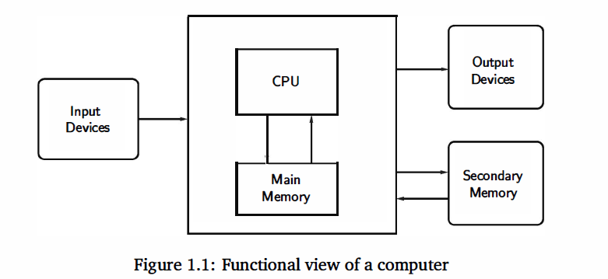
1.4 Hardware Basics

Slide 17
1.4 Hardware Basics
Memory stores programs and data.
CPU can only directly access information stored in main memory (RAM or Random Access Memory).
Main memory is fast, but volatile, i.e. when the power is interrupted, the contents of memory are lost.
Secondary memory provides more permanent storage: magnetic (hard drive, floppy), optical (CD, DVD)

Slide 18
1.4 Hardware Basics
Input devices
Information is passed to the computer through keyboards, mice, etc.
Output devices
Processed information is presented to the user through the monitor, printer, etc.

Slide 19
1.4 Hardware Basics
CPU follows a process called the fetch-execute cycle
First instruction retrieved from memory
Decode the instruction to see what it represents
Appropriate action carried out.
Next instruction fetched, decoded, and executed.
Lather, rinse, repeat!

Slide 20
1.5 Programming Languages
Natural language has ambiguity and imprecision problems when used to describe complex algorithms.
Programs expressed in an unambiguous , precise way using programming languages.
Every structure in programming language has a precise form, called its syntax
Every structure in programming language has a precise meaning, called its semantics.

Slide 21
1.5 Programming Languages
Programming language like a code for writing the instructions the computer will follow.
Programmers will often refer to their program as computer code.
Process of writing an algorithm in a programming language often called coding.

Slide 22
1.5 Programming Languages
Programming language like a code for writing the instructions the computer will follow.
Python is one example of a programming language and is the language that we will use throughout this semester.
There are other commonly used languages, such as C++, Java, Javascript, Ruby, Perl, Scheme, or BASIC.
Although these languages differ in many details, they all share the property of having well-defined, unambiguous syntax and semantics.

Slide 23
1.5 Programming Languages
High-level computer languages
Designed to be used and understood by humans
Low-level language
Computer hardware can only understand a very low level language known as machine language

Slide 24
1.5 Programming Languages
Example: Suppose we want the computer to add two numbers.
The instructions that the CPU actually carries out like:
load the number from memory location 2001 into the CPU
load the number from memory location 2002 into the CPU
add the two numbers in the CPU
store the result into location 2003
Low-level language

Slide 25
1.5 Programming Languages
How about high-level language?
Take python for an example, the addition of two numbers can be expressed more naturally: c = a + b
This needs to be translated into machine language that the computer can execute.
Compilers convert programs written in a high-level language into the machine language of some computer.

Slide 26
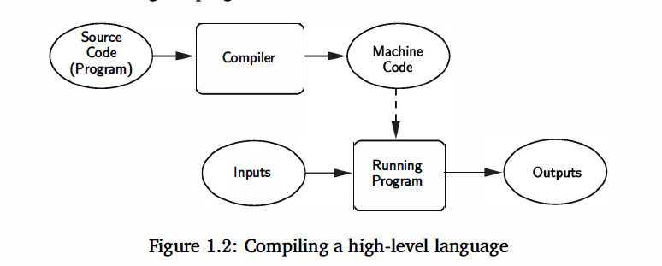
1.5 Programming Languages
Compilers convert programs written in a high-level language into the machine language of some computer.

Slide 27
1.5 Programming Languages
The high-level program is called source code, and the resulting machine code is a program that the computer can directly execute.
The dashed line in the diagram represents the execution of the machine code

Slide 28
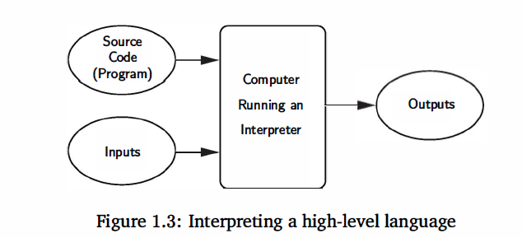
1.5 Programming Languages
Interpreters simulate a computer that understands a high-level language.
The source program is not translated into machine language all at once.
An interpreter analyzes and executes the source code instruction by instruction.

Slide 29
1.5 Programming Languages
Compiling vs. Interpreting
Once program is compiled, it can be executed over and over without the source code or compiler. If it is interpreted, the source code and interpreter are needed each time the program runs
Compiled programs generally run faster since the translation of the source code happens only once.

Slide 30
1.5 Programming Languages
Compiling vs. Interpreting
Interpreted languages are part of a more flexible programming environment since they can be developed and run interactively
Interpreted programs are more portable, meaning the executable code produced from a compiler for a Pentium won’t run on a Mac, without recompiling. If a suitable interpreter already exists, the interpreted code can be run with no modifications.

Slide 31
1.5 Programming Languages
Designing a computer program to fully understand human language is still an unsolved problem.

Slide 32
Homework
Install the Python, know how to run it.

Slide 33
1.6 The Magic of Python
When you start Python, you will see something like:
Python 3.9.6 (tags/v3.9.6:db3ff76, Jun 28 2021, 15:26:21) [MSC v.1929 64 bit (AMD64)] on win32
Type "help", "copyright", "credits" or "license()" for more information.
>>>

Slide 34
1.6 The Magic of Python
The “>>>” is a Python prompt indicating that Python is ready for us to give it a command. These commands are called statements.
>>> print("Hello, world“) Hello, world >>> print(2+3) 5 >>> print("2+3=", 2+3) 2+3= 5 >>>

Slide 35
1.6 The Magic of Python
Usually we want to execute several statements together that solve a common problem. One way to do this is to use a function.
>>> def hello(): print("Hello") print("Welcome to CS 120") >>>

Slide 36
1.6 The Magic of Python
>>> def hello(): print("Hello") print(“Welcome to CS 120") >>>
The first line tells Python we are defining a new function called hello.
The following lines are indented to show that they are part of the hello function.
The blank line (hit enter twice) lets Python know the definition is finished.

Slide 37
1.6 The Magic of Python
>>> def hello(): print("Hello") print("Welcome to CS 120") >>>
Notice that nothing has happened yet! We’ve defined the function, but we haven’t told Python to perform the function!
A function is invoked by typing its name.
>>> hello() Hello Welcome to CS 120 >>>

Slide 38
1.6 The Magic of Python
What’s the deal with the ()’s?
Commands can have changeable parts called parameters that are placed between the ()’s.
>>> def greet(person): print("Hello",person) print ("How are you?") >>>

Slide 39
1.6 The Magic of Python
>>> greet("Terry") Hello Terry How are you? >>> greet("Paula") Hello Paula How are you? >>>
When we use parameters, we can customize the output of our function.

Slide 40
1.6 The Magic of Python
When we exit the Python prompt, the functions we’ve defined cease to exist!
Programs are usually composed of functions, modules, or scripts that are saved on disk so that they can be used again and again.
A module file is a text file created in text editing software (saved as “plain text”) that contains function definitions.
A programming environment is designed to help programmers write programs and usually includes automatic indenting, highlighting, etc.

Slide 41
1.6 The Magic of Python
Example: Illustrate the use of a module file by writing and running a complete program.
def main():
print("This program illustrates a chaotic function")
x = eval(input("Enter a number between 0 and 1: "))
for i in range(10):
x = 3* x * (1 - x)
print(x)
We’ll use filename.py when we save our work to indicate it’s a Python program.
In this code we’re defining a new function called main.

Slide 42
1.6 The Magic of Python
>>> main()
This program illustrates a chaotic function
Enter a number between 0 and 1:0.5
0.75
0.5625
0.73828125
0.5796661376953125
0.7309599195141345
0.5899725467340735
0.7257148225025549
0.5971584567079203
0.7216807028704055
0.6025729979246489
>>>
Once you have typed it in, select File/Save from the menu and save it with the name chaos. py. The. py extension indicates that this is a Python module.

Slide 43
1.7 Inside a Python Program
# File: chaos.py
# A simple program illustrating chaotic behaviour
Lines that start with # are called comments
Intended for human readers and ignored by Python
Python skips text from # to end of line

Slide 44
1.7 Inside a Python Program
def main():
Beginning of the definition of a function called main
Since this program has only this one module, it could have been written without the main function.

Slide 45
1.7 Inside a Python Program
print("This program illustrates a chaotic function")
This line causes Python to print a message introducing the program.

Slide 46
1.7 Inside a Python Program
x = eval(input("Enter a number between 0 and 1: "))
x is an example of a variable
A variable is used to assign a name to a value so that we can refer to it later.
The quoted information is displayed, and the number typed in response is stored in x.

Slide 47
1.7 Inside a Python Program
for i in range(10):
For is a loop construct
A loop tells Python to repeat the same thing over and over.
In this example, the following code will be repeated 10 times.

Slide 48
1.7 Inside a Python Program
x = 3 * x * (1 - x)
print(x)
These lines are the body of the loop.
The body of the loop is what gets repeated each time through the loop.
The body of the loop is identified through indentation.
The effect of the loop is the same as repeating this two lines 10 times!

Slide 49
1.7 Inside a Python Program
for i in range(10):
x = 3 * x * (1 - x)
print(x)
These are same as
x = 3 * x * (1 - x)
print(x)
repeated 10 times

Slide 50
1.7 Inside a Python Program
x = 3 * x * (1 - x)
This is called an assignment statement
The part on the right-hand side (RHS) of the “=“ is a mathematical expression.
* is used to indicate multiplication
Once the value on the RHS is computed, it is stored back into (assigned) into x

Slide 51
1.7 Inside a Python Program
main()
This last line tells Python to execute the code in the function main

Slide 52
1.8 Chaos and Computers
The chaos.py program:
def main():
print("This program illustrates a chaotic function")
x = eval(input("Enter a number between 0 and 1: "))
for i in range(10):
x = 3* x * (1 - x)
print(x)
main()
For any given input, returns 10 seemingly random numbers between 0 and 1
It appears that the value of x is chaotic

Slide 53
1.8 Chaos and Computers
The function computed by program has the general form
where k is 3.
This type of function is known as a logistic function.
Models certain kinds of unstable electronic circuits.
Very small differences in initial value can have large differences in the output.

Slide 54
Homework
(a) Enter and run the calss example chaos.py program, using 2.0 in place of 3 as the multiplier in the function, and prints out 20 values instead of 10. (b)How about the number of values to print is determined by the user?
2. Modify the chaos.py program so that it accepts two inputs and then prints the output.
# to explain your codes if possible.

Slide 55
How to turn into the Homework
All the assignments are submitted through Canvas.
You need to have two parts of your assignments, program+output.
The program should be named as **.py
The output should be the word file or pdf file. (write your name)

